Slide 1
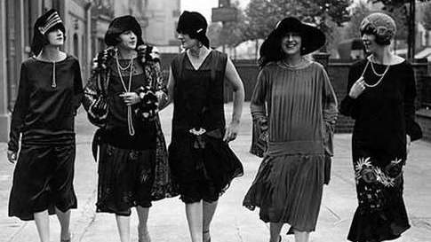
History Heroes
Week 7

Slide 2
1. What was one other name given to the Roaring Twenties?

Slide 3
2. On what date was the 19th Amendment passed by Congress? (full date, 3 marks)

Slide 4
3. On what date did Prohibition come into effect in the US? (3 marks)

Slide 5
4. When did the ‘Red Scare’ occur in America and what was it? (2 marks)

Slide 6
ANSWERS

Slide 7
1. The Golden Twenties The Decade of Prosperity The Republican Decade The Jazz Age The Period of Plenty

Slide 8
2. June 4, 1919

Slide 9
3. January 17th 1920

Slide 10
4. Wide-spread fears of communism in America caused the ‘Red Scare’ of December 1919 and January 1920. This resulted in the Boston Police Strike where a series of strikes occurred.

Slide 11
/9

Slide 12

Source of the week

Slide 13
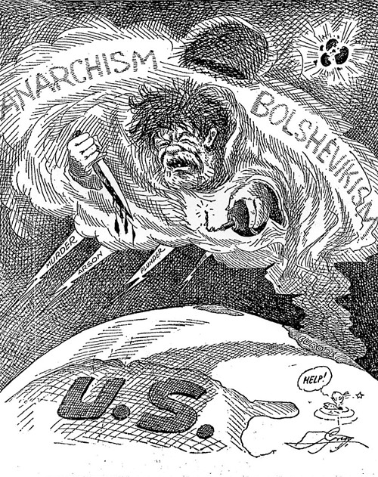
"The Cloud," The Atlanta Constitution, Jan. 19, 1919

